Slide 1
Bank Deposit Prediction model
Aarish Salam Memon (A20499744)
GROUP 374
Data Mining and Machine Learning (ITMD-522)

Slide 2
Introduction
A dataset from Kaggle Titled “Bank marketing campaigns dataset | Opening Deposit” has 21 columns having different data types. We would be performing a supervised learning task to get the prediction of the label of unseen data. The dataset has almost 42k observations and also has a very valuable column almost all of them would be used for the prediction models.
Source: Kaggle (https://www.kaggle.com/datasets/volodymyrgavrysh/bank-marketing-campaigns-dataset)

Slide 3
Research problem
There has been a revenue decline for the Portuguese bank and they would like to know what actions to take. After investigation, we found out that the root cause is that their clients are not depositing as frequently as before. Knowing that term deposits allow banks to hold onto a deposit for a specific amount of time, so banks can invest in higher gain financial products to make a profit. In addition, banks also hold a better chance to persuade term deposit clients into buying other products such as funds or insurance to further increase their revenues. As a result, the Portuguese bank would like to identify existing clients that have a higher chance to subscribe for a term deposit and focus marketing efforts on such clients.

Slide 4
SOLUTION (GOAL TO ACHIEVE)
To create a prediction model with higher accuracy, so we can conclude whether the marketing campaign was worthy or not.
Data Analysis
Data Preprocessing, Data Cleaning
Prediction Models (Classification)
Clustering

Slide 5
Features information (Columns)
1. Age (Numeric) – Age of the customer
2. Job - Type of job (Categorical)
3. Marital - Marital status (Categorical)
4. Education (Categorical) – States the education level
5. Default: has credit in default? (Categorical)
6. Housing: has housing loan? (Categorical)
7. Loan: has personal loan? (Categorical)
8. Contact: contact communication type (Categorical)
9. Month: Last contact month of year (Categorical)
10. Dayofweek: Last contact day of the week (Categorical)
11. Duration: Last contact duration, in seconds (numeric).

Slide 6
Features information (Columns) – CONT’d
12. Campaign: number of contacts performed during this campaign and for this client (numeric, includes last contact)
13. pdays: Number of days that passed by after the client was last contacted from a previous campaign (Numeric; 999 means client was not previously contacted)
14. Previous: Number of contacts performed before this campaign and for this client (numeric)
15. poutcome: outcome of the previous marketing campaign (Categorical)
16. emp.var.rate: employment variation rate - quarterly indicator (numeric)
17. cons.price.idx: consumer price index - monthly indicator (numeric)
18. cons.conf.idx: consumer confidence index - monthly indicator (numeric)
19. euribor3m: Euribor 3-month rate - daily indicator (numeric)
20. nr.employed: number of employees - quarterly indicator (numeric)
21 - y - has the client subscribed a term deposit? (Binary: "Yes", "No")

Slide 7
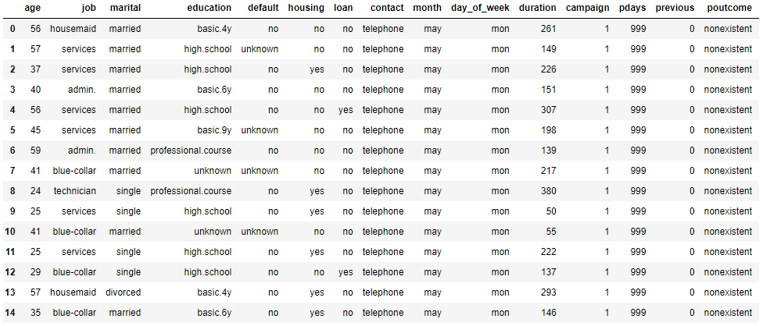
Dataset head

Slide 8
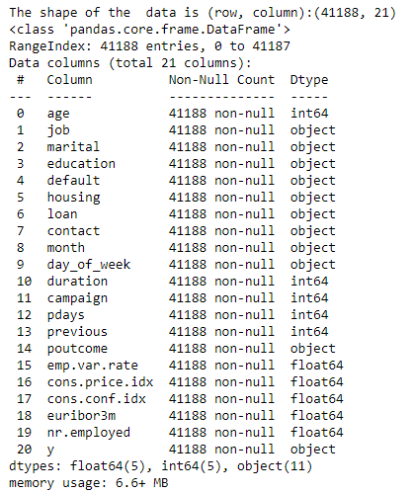
Dataset information

Slide 9
Project task
Task - Binary Classification
Models Used – KNN, Naïve Bayes, SVM, Logistic Regression, Decision Trees, and Random Forests, and Neural Networks.
Outliers Removed
Clustering - Kmeans Clustering
Evaluation – N-Folds Evaluation, Accuracy, Precision, Recall, F1 Score.

Slide 10
MOVING ON to Data Analysis

Slide 11
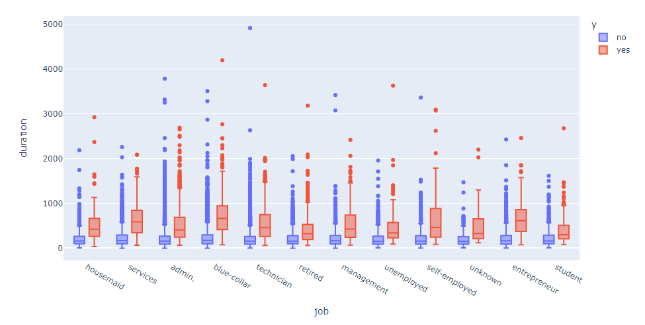
Duration of calls v/s job (Deposit=Color)
The leads who have not made a deposit have lesser duration on calls
Comparing the average, the blue collar, entrepreneur have high duration in calls and student, retired have less duration in average
Large distribution of leads were from self employed clients and management people

Slide 12
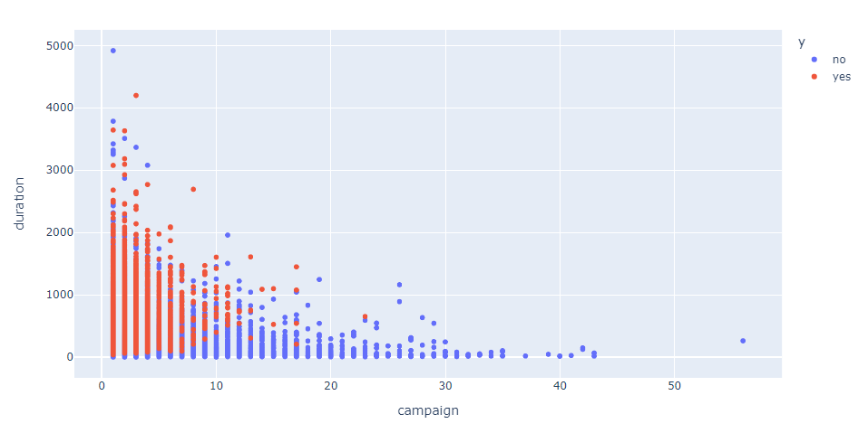
Duration of calls v/s campaign (Deposit=Color)
The more the duration the calls were, they had higher probability in making a deposit
Duration of calls faded as the time period of campaign extended further
There were many positive leads in the initial days of campaign

Slide 13
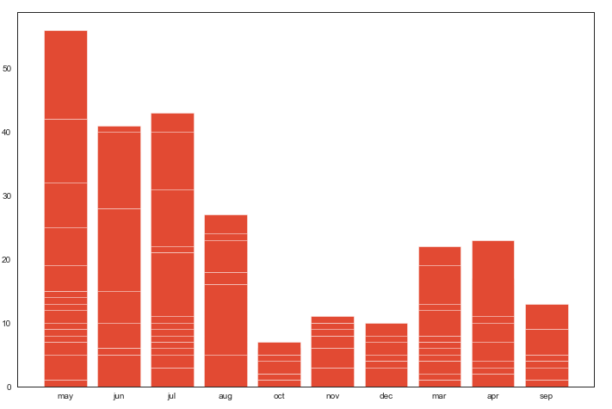
MONTH v/s campaign
We can see the campaign was mostly concentrated at the starting of the bank period ( May, June, and July)
Usually education period starts during that time so there is a possibility that parents make deposits in the name of their children
They also have made their campaign in the end of the bank period.

Slide 14
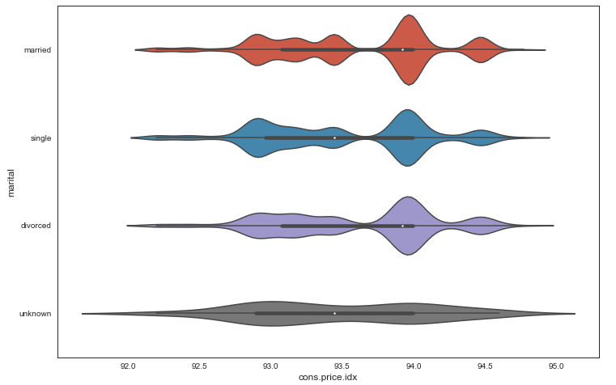
Marital v/s consumer price index.
There are very minute differences among the price index
Married leads have considerably have an upper hand as they have index contributing as couple

Slide 15
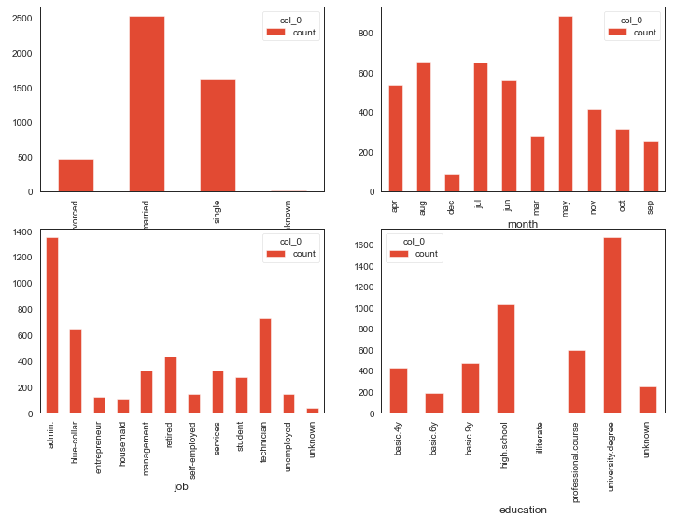
Count of (Marital, month, job, education)
Married leads have made high deposits followed by single
There were much deposits made during may month as it is the start of bank period
Leads who work in administrative position made deposits followed by technicians and blue collar employees
Leads who had atleast university degree had made the deposits followed by high school

Slide 16
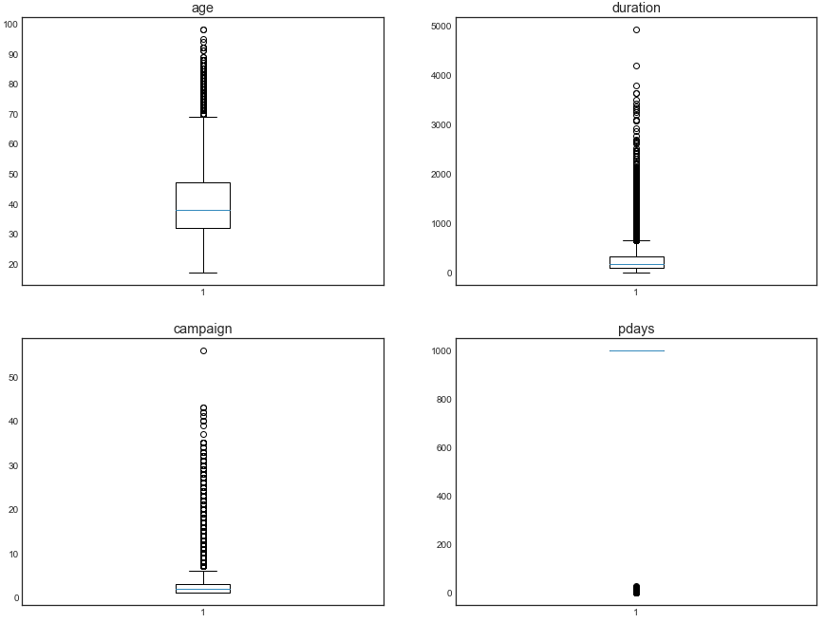
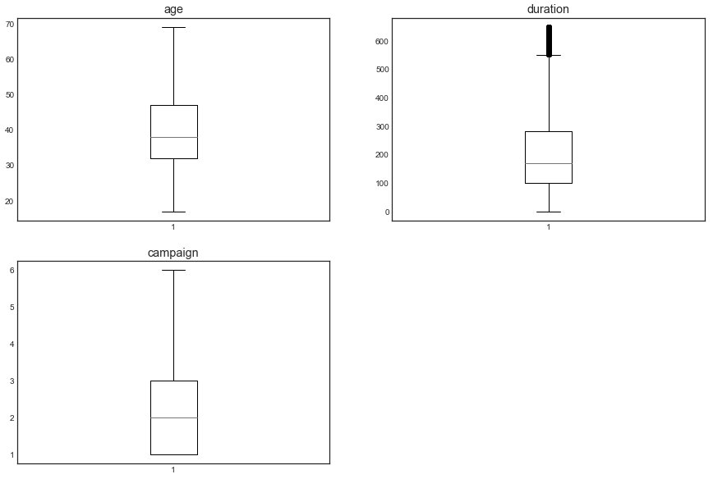
Outlier detection and removal
Outlier detection
Outlier removal

Slide 17
Data pre-processing
Used multiple techniques for data pre-processing
Created two settings, one for KNN and other for Naïve Bayes
Targeted Ordinal Encoding, Frequency Encoding, and Dummies
Converted all categorical data to numerical for KNN
Converted numerical data to categorical for Naïve Bayes

Slide 18
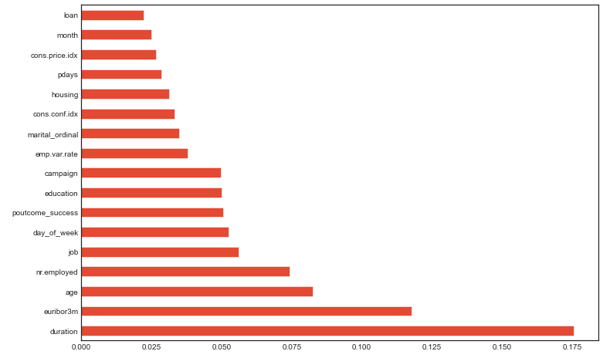
Feature selection and reduction
Selected Top 15 features for our models.
From the bar plot we can see the importance of features based on their impact towards output

Slide 19
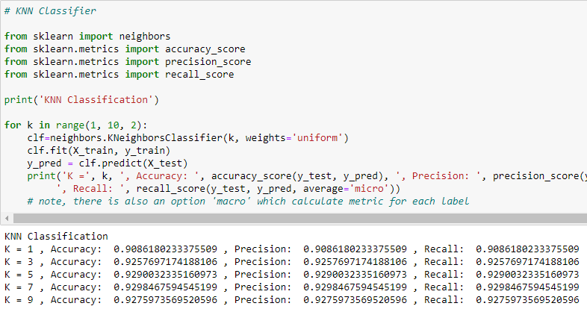
Knn classifier
Accuracy is almost 93%
K ranging from 1 to 9
Evaluation – Accuracy, Precision and Recall.

Slide 20
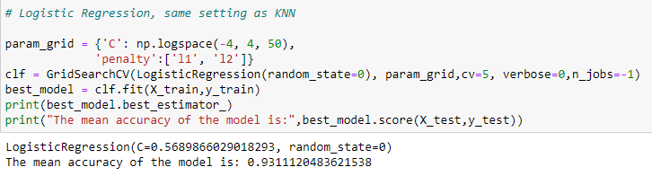
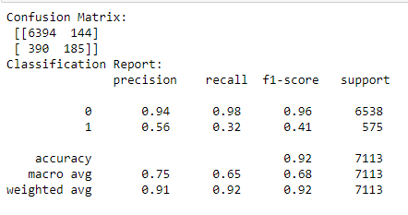
Logistic regression classifier
Accuracy is over 93%
The Confusion matrix result is telling us that we have 6394+185 correct predictions and 390+144 incorrect predictions.
The Classification report reveals that we have 94% precision which means the accuracy that the model classifier not to label an instance positive that is actually negative which is important as we shouldn't label a lead as positive in making a term deposit when he/she isn't interested in making a deposit

Slide 21
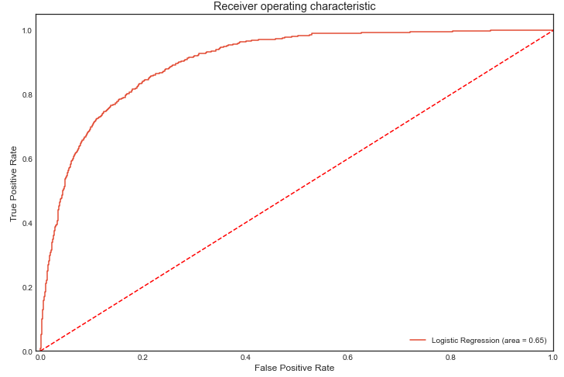
ROC Curve
From the ROC curve we can infer that our logistic model has classified the prospective leads who made deposit correctly rather than predicting false positive. The more the ROC curve(red) lies towards the top left side the better our model is. We can choose any value between 0.8 to 0.9 for the threshold value which can reap us true positive results

Slide 22
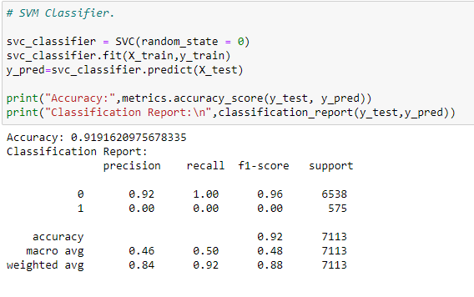
SVM Classifier
Accuracy is almost 92%
Evaluation – Accuracy, Precision, Recall and F1 Score.

Slide 23
Naïve bayes, decision trees, random forest and neural networks.
Accuracy for Naïve Bayes is almost 78%
Accuracy for Decision Tree is almost 92%
Accuracy for Random Forest is 63%
Accuracy for Neural Networks is almost 92%

Slide 24
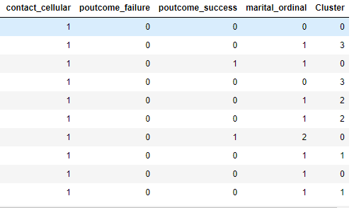
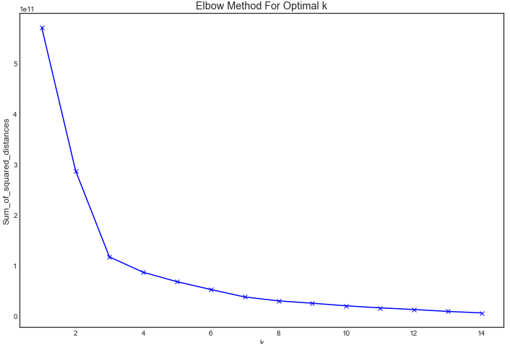
Kmeans clustering
Cluster column in table
Elbow method for best K value
Clustering process to check if there’s any improvement to our model, but turns out there is no
change in the accuracy of our model.

Slide 25
conclusion
Best Setting - Logistic Regression is our best model having an accuracy of 93%
Future Work & Suggestions - Classify job roles based on corporate tiers and approach all tier 1 employees within a few days after the campaign commences
Listen to the leads and extract more information to deliver the best deposit plan, which can increase the duration of calls and that can lead to a deposit
Approaching the leads during the start of the new bank period(May-July) will be a good choice as many have shown positive results from data history
Tune the campaign according to the national econometrics, don't channelize the expenses on the campaign when the national economy is performing poor

